Slide 1
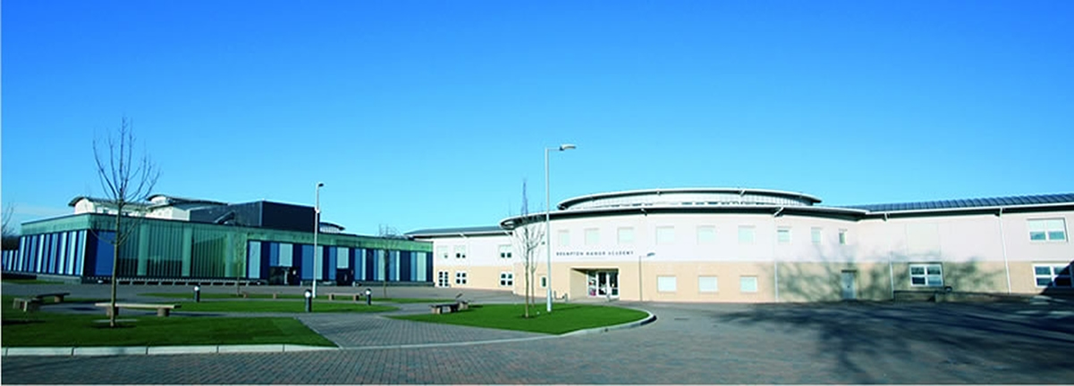


Brampton Manor Academy
Year 7 Information Evening
Success through effort and determination
Notes:
To provided information on how you can support your child in regards to academic excellence.
Understanding of the curriculum provided
Understanding of the way in which assessment will take place
Understanding of School expectations
To provided information on how to support your child to stay safe and healthy.
Understanding PSHCE/SMSC –program, how it is taught
Extra- curricular – educational, clubs, passport
Behaviour code –school rules, iris,, redits, bullying, Poster
E- safety – impero,)
Who to contact :-

Slide 2
THE MAIN AIMS OF THIS EVENING ARE:
To give you an overview of the year 7 curriculum and how your child will be assessed.
To equip you with information about how we will support your child to get the very best out of their education at Brampton Manor Academy.
To strengthen our partnership with you in order to enable your child to thrive and succeed here at Brampton Manor.
To deal with any questions/issues at this early stage of your child’s educational journey here at Brampton Manor.
Success through effort and determination
Notes:
To provide information on how you can support your child in regards to academic excellence.
Understanding of the curriculum provided
Understanding of the way in which assessment will take place
Understanding of School expectations
To provide information on how to support your child to stay safe and healthy.
Understanding PSHCE/SMSC –program, how it is taught
Extra- curricular – educational, clubs, passport
Behaviour code –school rules, iris,, redits, bullying, Poster
E- safety – impero,)
Who to contact :-

Slide 3
THE SCHOOL DAY AND CURRICULUM
YEAR 7 CURRICULUM SUBJECTS
Biology 1 hr
Chemistry 1 hr
Computing 1 hr
English 4 hrs
French 3 hrs
Geography 1 hr
History 2 hrs
Mathematics 3 hrs
Physics 1 hr
Art and Design 1 hr
Drama 1 hr
Music 1 hr
PE 2 hrs
Religious Studies 1 hr
Technology 1 hr
Food Nutrition 1 hr
CPSHE Registration time
THE SCHOOL DAY
There are 5 lessons each day
Each lesson is 1 hour long
8:15- 8:35 Registration
8:35- 9:35 Lesson 1
9:35-10:35 Lesson 2
10:35-10:55 Short Break (20 min)
10:55-11:55 Lesson 3
11:55-12:55 Lesson 4
12:55-1:35 Lunch Break (40 min)
1:35-2:35 Lesson 5
EBACC
Success through effort and determination
Notes:
Importance of being organised
Draw attention to the booklet- topics and how to support the child
Students are seted in all subjects except exp. arts, technology, this is for ability appropriate teaching
- Based on KS2 data – students are not restricted to improvement as progress will be measured through assessments

Slide 4
SUPPORT FOR LITERACY AND NUMERACY
At the start of year 7, we identify students that are in need of extra literacy and/or numeracy support using data from KS2:
These students receive specific literacy and/or numeracy intervention and their progress is constantly monitored.
Good literacy and numeracy skills underpins success across all subjects and in later life. Therefore, we ensure that:
Literacy and numeracy remain a key focus in ALL lessons for ALL students
We constantly assess the students literacy and numeracy skills
We provide specific and individualised support to address any needs
Success through effort and determination
Notes:
Everywhere- every lesson speaking and listen and writing everyone's responsibility
Encourage their child to read
Everywhere- mathematical understanding in all subjects- statistics use of number
Narrowing differences -

Slide 5
ASSESSMENT OF LEARNING AND PROMOTING GOOD STUDENT PROGRESS
THE PROGRESS OF YOUR CHILD WILL BE ASSESSED REGULARLY IN THE FOLLOWING WAYS:
Questioning in lessons
Homeworks/Research work
Class discussions/Group work
End of topic tests
THERE WOULD ALSO THREE FORMAL ASSESSMENTS DURING THE YEAR AS FOLLOWS:
Term 1
Week beginning Monday 28th November 2016
Term 2
Week beginning Monday 13th March 2017
Term 3
Week beginning Tuesday 6th June 2017
REPORTING
We will report to you termly on the progress and achievement of your child.
We will also invite you to Parents’ evenings to discuss your child’s progress.
Success through effort and determination
Notes:
Explain the format of assessment weeks
Revision material- class book or revision guides

Slide 6
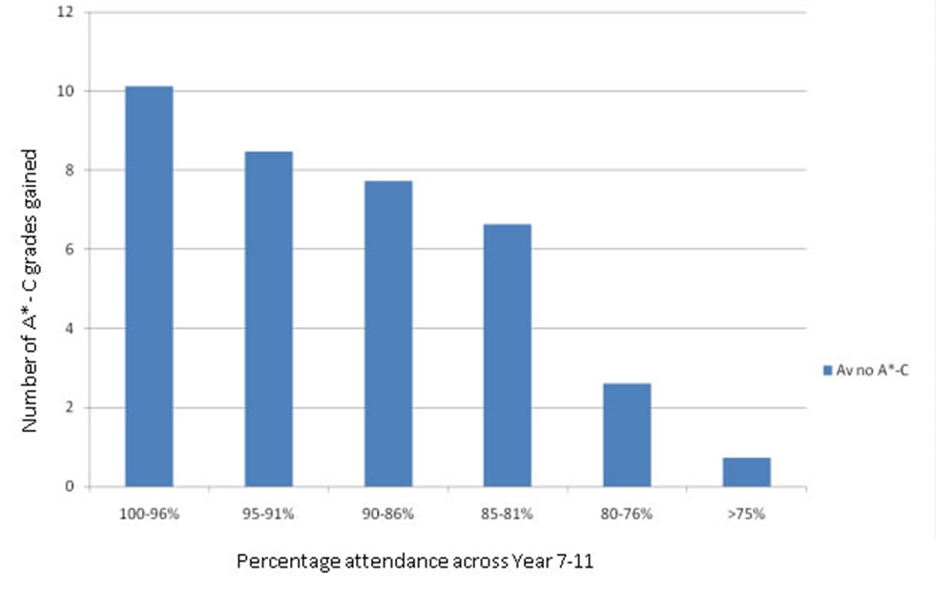
GOOD ATTENDANCE MATTERS
There is a strong correlation between high attendance and good achievement.
Success through effort and determination
Notes:
-Discuss what to do if your child is not coming school.
Also what we do if child feels unwell
Below 95% we refer to EWO within the school

Slide 7
GOOD ATTENDANCE MATTERS
“It’s only one day”
“It’s only one day” But on that one day you might miss:
Period 1: Introduction to a new topic in English
Period 2: Explanation of a new concept in Maths
Period 3: An important experiment in Science on which your later work is based
Period 4: 12-20 new words/phrases in a foreign language plus a grammatical concept
Period 5: A demo in food preparation showing what you are expected to do in the next lesson
Success through effort and determination
Notes:
-

Slide 8
WHAT TO DO IF YOUR CHILD IS ABSENT FROM SCHOOL
If you child is absent for a day, you must inform the school in the following way:
Call the school on 020 7540 0500, choose option 1 and leave a message clearly stating your child's name and form group, along with the reasons for absence.
Email the school using the email: info@bramptonmanor.org and leaving the information as above.
We follow-up on all unauthorised absences and will convene multi-agency meetings in the most serious cases. Persistent absences will not be tolerated.
Ensure that your child catches up on all work missed, including any homework. This may require your child to attend after-school/lunch-time catch-up classes.
PLEASE DO NOT BOOK HOLIDAYS DURING TERM-TIME.
Success through effort and determination
Notes:
-Mention it is important that the student brings a note in regardless of the above for his/her file.
It must be signed by the parent/carer
- Explain that it is the childs responsibility to catch up on any missed work including any homework set when they were away

Slide 9
GOOD PUNCTUALITY MATTERS
Good punctuality is essential to do well in school and later life
Poor punctuality goes on their record and stays there
Your child will always have to make up the misses time after school
Sanctions for poor punctuality:
First late Ten minutes
Second late One hour
Third late Two hours
Every late after this Saturday detention
Success through effort and determination
Notes:
-Mention punctuality is important in jobs – consistently late and you lose your job
Mention references for college and how we have to be honest
Being on time will help you to be relaxed and focused first thing in the morning
Mention sanctions for students who are late in the morning

Slide 10
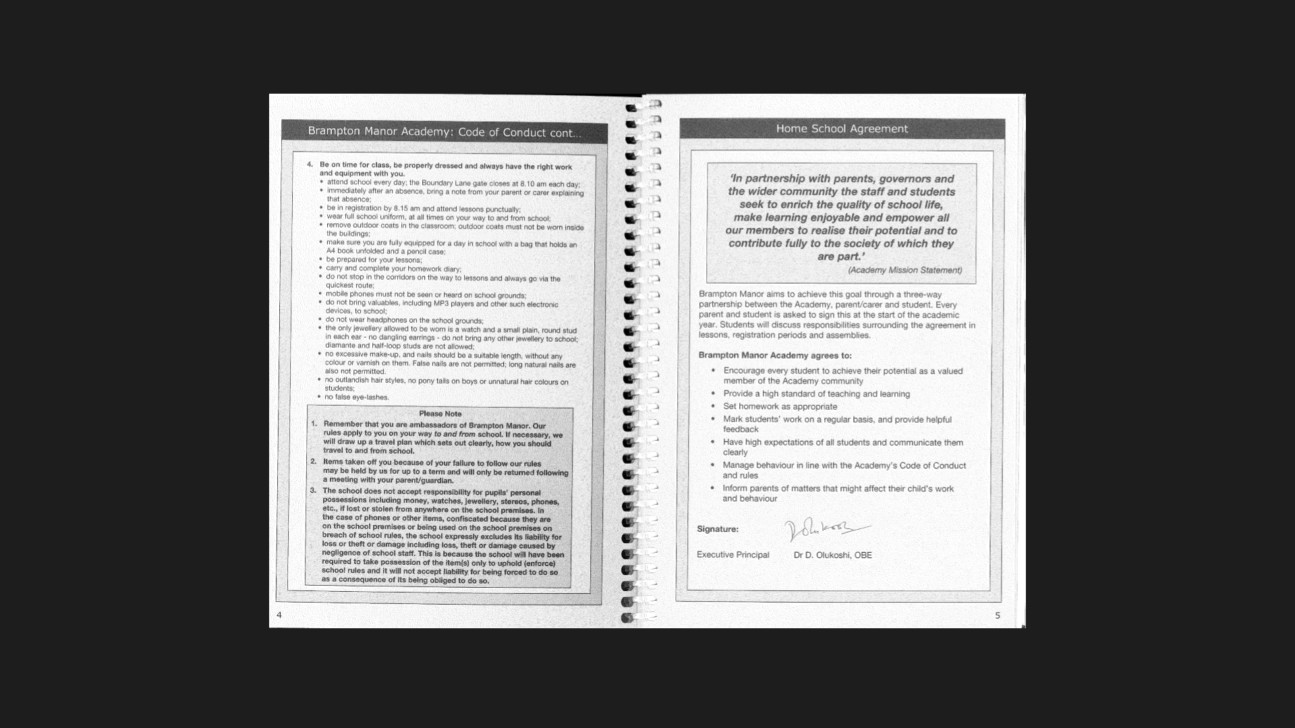
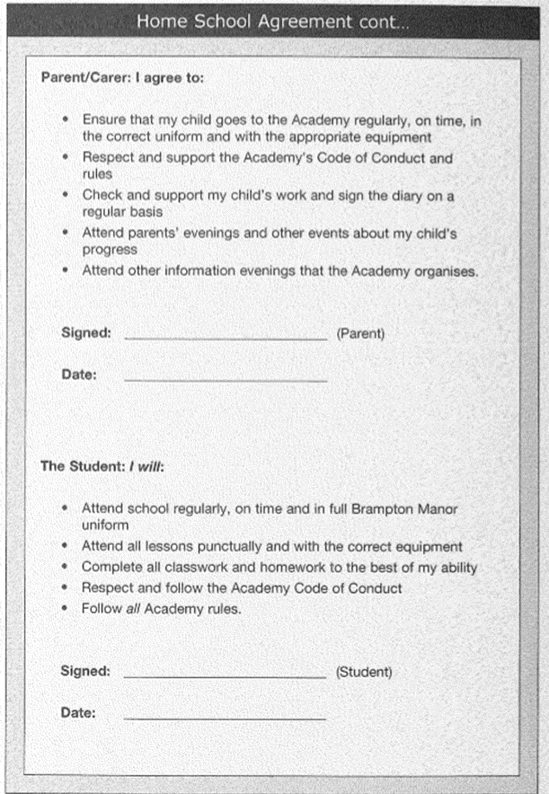
HOME SCHOOL AGREEMENT
Expectations
Success through effort and determination
Notes:
-Discuss home school agreement

Slide 11
OUR SCHOOL RULES
Success through effort and determination
Notes:
-Discuss home school agreement

Slide 12
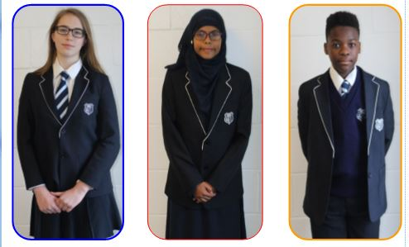
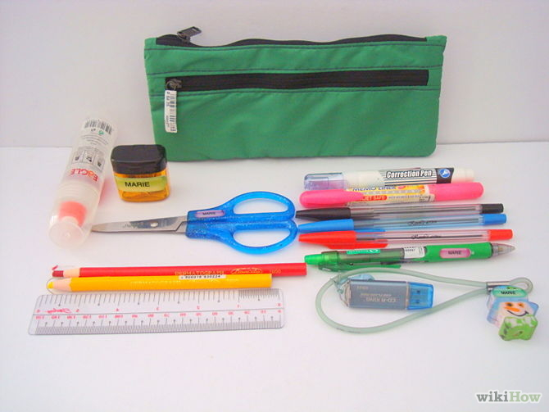
UNIFORM AND EQUIPMENTS
Come to school ready for learning in the correct uniform
Ensure you have your Pens, Pencils, Rulers, Exercise Books, Diary and an A4 bag
Success through effort and determination
Notes:
Our expectations

Slide 13
HOMEWORK – DEVELOPING INDEPENDENT LEARNING SKILLS
Homework provides our students with the opportunities to develop valuable independent learning skills.
The home learning skills are varied and include:
Questions to check understanding and consolidate learning
Research-based activities
Individual/group projects
Students will receive homework in each subject every week. Each homework is 30 minutes long.
There is a lunchtime and after-school homework club to help students with their homework.
HOME LEARNING TIMETABLE (30 minutes per subject each week)
MONDAY | TUESDAY | WEDNESDAY | THURSDAY | FRIDAY
MUSIC HISTORY DRAMA | FRENCH GEOGRAPHY PE CHEMISTRY | PHYSICS RELIGIOUS STUDIES FOOD & NUTRITION | ENGLISH COMPUTING DESIGN & TECHNOLOGY | MATHS ART BIOLOGY
Success through effort and determination
Notes:
- Add MRA slide which suggests ways students can organise their learning at home

Slide 14
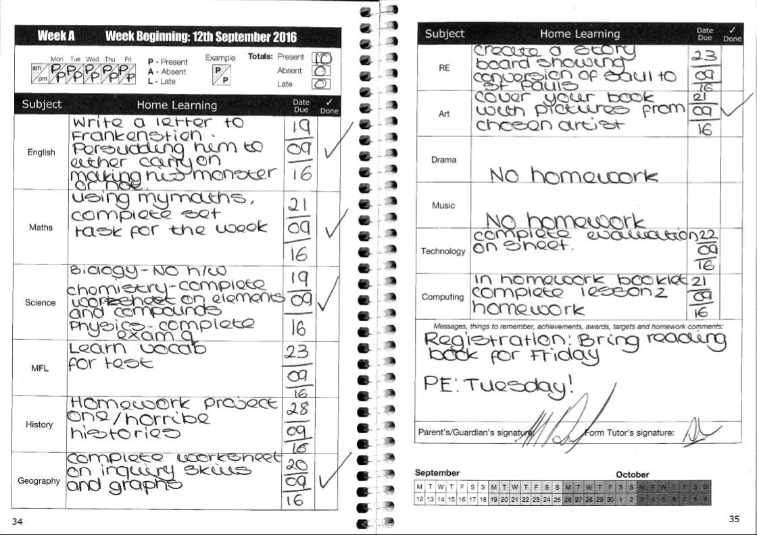
RECORDING AND MONITORING OF HOMEWORK
Homework clearly copied
from board
Due date clearly
stated
Parent
signature
Form tutor
signature
Success through effort and determination

Slide 15
WHAT WE WILL DO TO SUPPORT YOU AND YOUR CHILD
Provide high quality teaching to enable your child to learn and make progress
Personalise learning to enable every student to make aspirational progress
Have high expectations of what your child can achieve
Respond promptly and robustly to any concerns you raise with us
Success through effort and determination
Notes:
Everywhere- every lesson speaking and listen and writing everyone's responsibility
Encourage their child to read
Everywhere- mathematical understanding in all subjects- statistics use of number

Slide 16
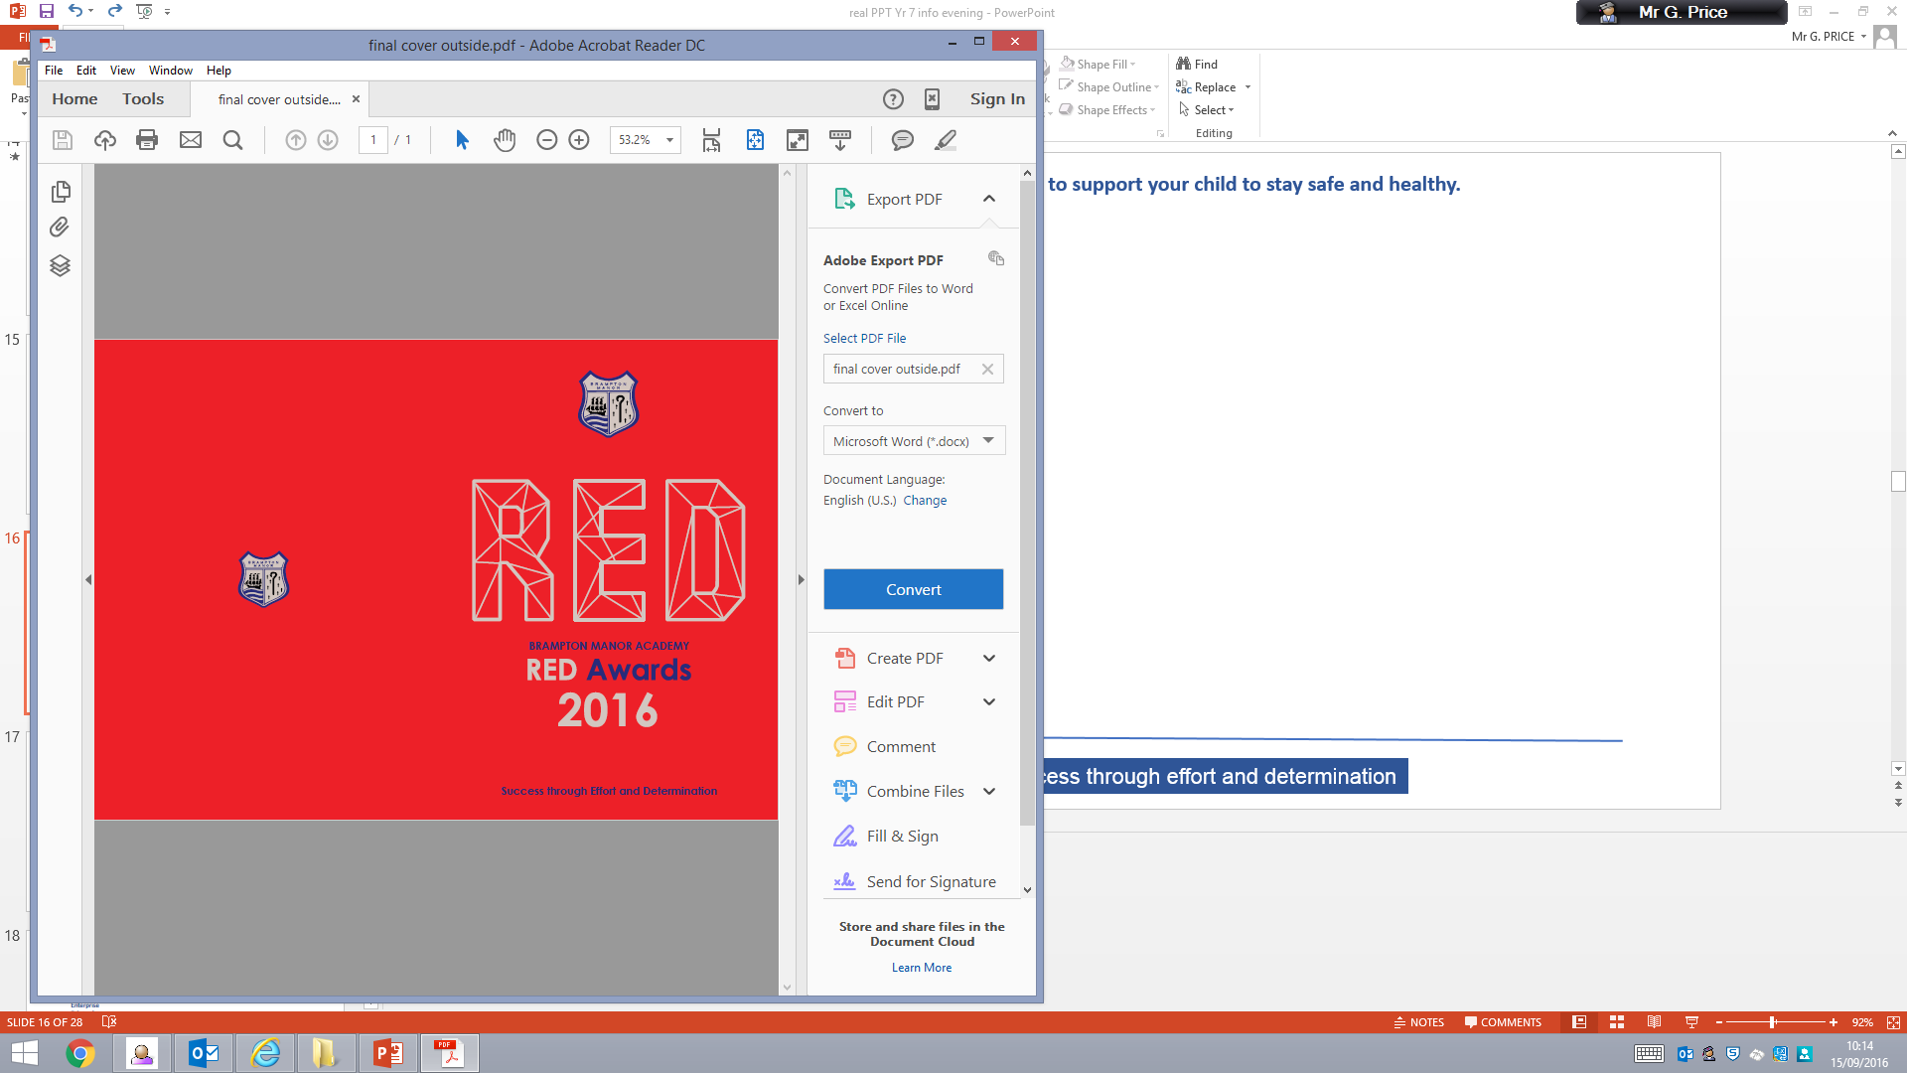
Success through effort and determination

Slide 17

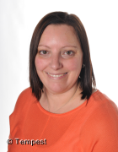

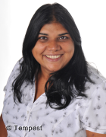
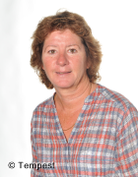


KEEPING OUR CHILDREN SAFE
.
Miss Gotobed
Education Welfare Officer
Mr Price
Assistant Principal
Behaviour
Ms Kaiser
Designated Senior Leader
(Safeguarding)
Mrs O’Brien
Designated Senior Leader
(Safeguarding)
We are here to help
Mrs A Bhunjun
Progress Leader— Yr 7
Mr Howard
Yr 7 Behaviour Support Manager
Success through effort and determination
Notes:
However we are not a school who will ever say it does not exist

Slide 18
THE WIDER CURRICULUM
Personal, Social & Health Education (PSHE)
This is taught through:
Form time activities,
Assemblies and
Skills days
The programme of study incorporates the following:
Diversity in our community
Enterprise
Fair trade
Healthy lifestyles
Moral decision making
Responsibility to the earth
SRE
Target setting
Voting and democracy
Careers education
Success through effort and determination

Slide 19
Wider curriculum
Success through effort and determination

Slide 20

Wider curriculum
Success through effort and determination

Slide 21
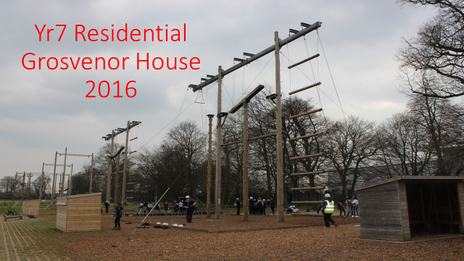
LEARNING OUTSIDE OF THE CLASSROOM
Success through effort and determination

Slide 22
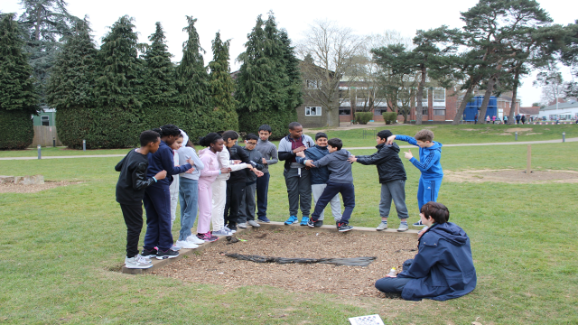
LEARNING OUTSIDE OF THE CLASSROOM
Success through effort and determination

Slide 23



ONLINE SAFETY – TOP TIPS
Encourage the use of technology in public areas of the house
Games consoles have ‘parental controls’ and be aware some games are over 18’s
Encourage your children not to:
Open emails from senders they don’t know
Share their personal information
Make friends with or accept friend requests from people they don’t know on social media
Talk openly to your children about the risks associated with the internet
Be aware of what photos/images they store in their phone – once out there, the whole world can see it!
26
Success through effort and determination

Slide 24
HOW WE HELP STUDENTS TO STAY SAFE ONLINE
We teach students about online safety in lessons, workshops and assemblies
We teach students about how they can be socially responsible online
We teach students about the risks and opportunities associated with online/social media activity
We actively monitor our pupils online activity whilst they are using any of our computers and take appropriate action against students accessing or attempting to access prohibited sites and/or images
Success through effort and determination
Notes:
Everywhere- every lesson speaking and listen and writing everyone's responsibility
Encourage their child to read
Everywhere- mathematical understanding in all subjects- statistics use of number

Slide 25
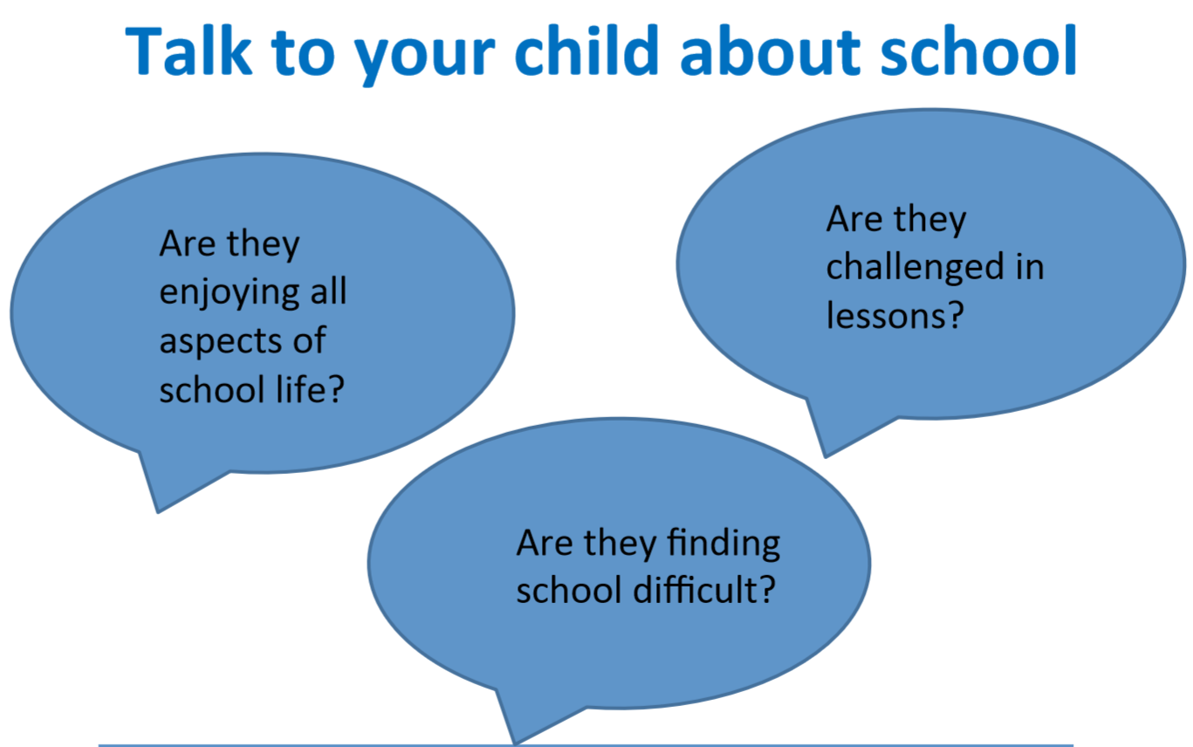
Success through effort and determination

